Slide 1
Slide Instructions
<Note: Remove this slide prior to presenting the brief.>
Instructions:
Text in <brackets and bold blue> is instruction and should be removed prior to presenting brief.
Text in bold blue, without brackets, is an example of one way to complete the slide text and should be addressed, removed, or replaced prior to presenting brief.
See Slide Notes supporting each individual slide.
Slides do not need to be 100% completed for AO presentation.
If completing this brief for Cloud Services, please complete the Cloud Slides found in the backup slides.
Apply applicable markings to briefing as well as Body of Evidence (BOE) in accordance with Program Security Classification Guide (SCG).
Notes:
Please add system name, PM, and date

Slide 2
OVL AO Determination Briefing SYSTEM/CAPABILITY NAME
Authorizing Official:
AODR:
CRA:
Program Manager:
ISSM:
eMass/Xacta record:
Date:
Note: Add Classification and Portion Markings as appropriate (remove before submission).
DISTRIBUTION STATEMENT A: Distribution approved for public release when not filled in on 16 June 2023 distribution is unlimited. DESTRUCTION NOTICE: Must be completed when filled in. Case Number: AFLCMC-2021-0037 ​
Notes:
Please add system name, PM, and date
This is a joint briefing between the program/system/capability ISSM and the CRA. It is the Executive Summary to the Authorizing Official of the request for a determination. It documents the point in time that the authorization determination is made.
It is part of the Authorization Package that is documented.
This briefing provides an overview of the system/capability, the architectures, the data flows, the CONOPS, the technologies, the supply chain, the Risk analysis, the mitigated risk areas, the unmitigated risk areas, the POA&M, the CONMON and the IR.
It outlines the system/capability, the risk posture, the agreed too conditions between the PM and the AO, and the items that will be addressed per the Authorization conditions.
This AO Determination Briefing forms the basis for communicating the Risk posture of the System/Capability to other stakeholders, to other AO’s, to aid reciprocity and to inform others on the risk of use posture of the system/capability.

Slide 3
<Program> and AO Team
Program Team
PM, Name, Organization
ISO, Name, Organization
ISSM, Name, Organization
ISSE, Name, Organization
Pen Test Lead, Name, Organization
Program Support, Name, Organization
AO Team
AO, Mr. Daniel Holtzman, CDAO
AODR, Name, Organization
CRA, Name, Organization
Program
Assess and Authorize
Cyber
Team Sport
Team of Teams Concept: Teams collaborate, but assessors must be independent.

Slide 4
Bottom Line Up Front (BLUF)
Obtain an authorization determination for <System Name>
<Outline mission need and strategic agenda>
Seeking an IATT to support the “XXX” training exercise scheduled for “day month year” through “day month year”
<Provide projected schedule>
<Describe Assumptions and Constraints>
Industry Partners/Services, Foreign Partners/Customers
Authorized interconnection between “XXX” and “YYY”
Network/Boundary Limitations
<Provide scope/boundary of assessment>
PIT System, Type Accreditation, Stand Alone, Enterprise, etc.
Current Status: <List current or last approval, other circumstances>
Approval and Expiration, under testing (IATT), etc.
The overall level of residual risk of <System Name> is assessed to be <L,M,H>
The CRA recommends AO <Concur/Non-concur> <recommendation> to support deployment of <System Name> through <Authorization Termination Date (ATD)>.
Notes:
Reference NIST SP 8510.01 and NIST SP 800-37
Describe the intention of the briefing. Why are we here and what do you want from the AO? Simple statement, direct and to the point. The determination can be either for ATO, ATO with conditions, IATT or DATO.
The line: “This is a Type Authorization under Reciprocity.” is necessary if it applies and any other pertinent information that needs to be identified up front.
The Current situation should describe previous authorizations and dates or that it is an initial (new) assessment and need date. The AO and CRA need these details up front to understand and assist.
The Cyber Risk Assessor (CRA) is the official having the authority and responsibility for the assessment of all ISs and PIT systems governed by a DoD Component Cybersecurity Program. The CRA evaluates the cybersecurity capabilities and services of a DoD IS and PIT system and makes a recommendation for risk acceptance or denial to the AO.
This recommendation accompanies the RMF security authorization package and serves as the primary basis for the AOs authorization determination. The CRA continuously assesses and guides the quality and completeness of RMF activities and tasks and the resulting artifacts. The DoD Component SISO either performs the CRA functions or formally appoints SCA Representatives to do so for all governed ISs and PIT systems.
Specific duties include (taken from NIST SP 800-37):
Develop, review, and approve a plan to assess the risk.
Assess the security risks in accordance with the assessment procedures defined in the security assessment plan
Prepare the security assessment report documenting the issues, findings, and recommendations from the security risk assessment
Conduct initial remediation actions on security risks based on the findings and recommendations of the security assessment report and reassess remediated risk(s), as appropriate.
Assess a selected subset of the technical, management, and operational security risks employed within and inherited by the information system in accordance with the organization-defined monitoring strategy.

Slide 5
Mission and System Description
<In one paragraph, describe mission.>
<Provide a high-level description of the system. Include System Categorization and Classification Level.>

Slide 6
Cyber Security and Resiliency Enablers
The items below should be conveyed to the AO within this briefing; these slides are NOT to be filled out. Please remove this slide prior to submission.
<What is the System? What does it do? CONOPS? Missions?>
<What is the System Architecture? Weapon System (e.g., Aircraft, Ground Systems, Maintenance Systems, Training Systems, etc.)>
<List of Hardware (LRU), Software and providence of each (e.g., supply chain); identification of Critical Program Information (CPI), Critical Components (CC); Technical Orders, Operational Procedures. Identification of technologies being used.>
<Identification of all external communications access points.>
<How does data flow into, through, and out of the system? What type of data is it? How is it protected? Where does it come from? Where does it go? What is it used for?>
<What threat/intel information is available?>
This is the set of Enablers that should be addressed during the rest of the briefing
This chart can be moved to back up. it can be a pointer to the charts in the briefing that address the areas.
IT IS A TEMPLATE CHART – THE BRIEFING SHOULD ADDRESS THESE AREAS
Notes:
Reference only, remove slide before submission.
Reference NIST Special Publication 800-161
Identify your programs supply chain risks for the information system.

Slide 7
Supply Chain Risks
The items below should be conveyed to the AO within this briefing; these slides are NOT to be filled out. Please remove this slide prior to submission.
<Bill of Materials (BOM) - As part of the systems engineering (SE) process, especially in a legacy system, programs already know all parts (hardware and software).>
<Existing supplier management process identifies supplier source, End of Life (EOL) analysis, and alternate part analysis. (Document “As-Is”)>
<Existing criteria being used by primes and flowed down to subs, on purchasing of parts is known?>
<What is the supply chain mapping? Does one exist already?>
<With the data collected from items 1-4 above, review the potential risks of the supply chain>
<Provide available intel/threat info that can be applied against the list of parts or suppliers identified (or technologies)>
<Provide an assessment of risk of the current supply chain>
<Provide a graphical representation of the supply chain>
This is the set of Enablers that should be addressed during the rest of the briefing
This chart can be moved to back up. it can be a pointer to the charts in the briefing that address the areas.
IT IS A TEMPLATE CHART – THE BRIEFING SHOULD ADDRESS THESE AREAS
Notes:
Reference only, remove slide before submission.
Reference NIST Special Publication 800-161
Identify your programs supply chain risks for the information system.

Slide 8
System Architecture
EXAMPLE
<Add high level system description here.>
The architecture diagram describes the system architecture – how things work, the parts or sub parts of the system
Notes:
Reference Only…replace architecture
This is the level of detail that is needed.
The system architecture should show the AO what the architecture is, physical location, encryption, interfaces and protocols, physical and technical protection mechanisms, vendor access, etc.
A system Architecture is the conceptual model that defines the structure, behavior, and more views of a system. An architecture description is a formal description and representation of a system, organized in a way that supports reasoning about the structures and behaviors of the system. Identify the architecture, locations, encryption, interfaces, protocols, physical and technical protection measures, vendor access, etc.

Slide 9
Interconnection(s)/Interface(s)
Represents External Interfaces/AO Boundaries
EXAMPLE
Identify all interfaces, data flows, connections in/out of the authorization boundary.
Every interface represents a connection to another system/capability and AO boundary that needs to be addressed.
Notes:
Reference Only…replace architecture
Describe the interconnections/data flows this system has with any external systems or networks. Describe what the external connections are: PITI’s, other external connections, standalone system, etc.
This is the level of detail on the communications needed – all in/out links
This is reused from the determination briefing and updated

Slide 10
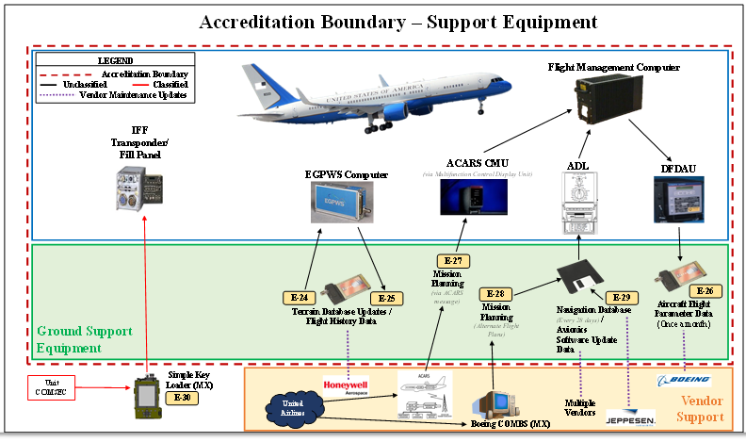
Authorization Boundary
EXAMPLE
The Red dashed box in this example is showing the boundary of the authorization. Everything inside the Red dashed box is part of the authorization. ALL connections and data flows in/out of the red dashed box represent areas that require being addressed as connections and data flows in/out of the authorization boundary
Notes:
Reference Only…replace architecture
The authorization boundary diagram must specifically identify what is included in the boundary. The AO risk acceptance determination will be strictly based on threat/vulnerability pairs identified within the specific boundary.
The main purpose of this chart is an example of WHAT is in the boundary of the Authorization that the AO is being asked to assess and make a determination on. As shown by the RED dashed line (see the legend). What is IN the boundary of the authorization, and what is EXTERNAL to the boundary of the authorization. This chart is an example of an “Airplane Weapon system” boundary.

Slide 11
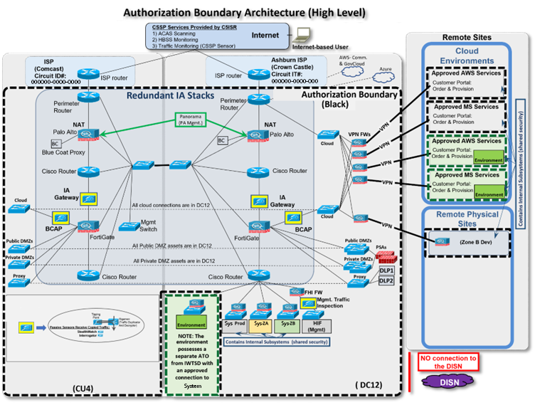
SYSTEM NAME Authorization Boundary
EXAMPLE
EXAMPLE of a cloud-based system authorization boundary
Notes:
Reference Only…replace authorization boundary
This shows what is authorized.
It should have a ledged and be standard across all Tag Up briefings
For example – this chart shows TWO authorizations, one in black dashed one in green dashed
This should show the AO what is under authorization. It should have a very clear line or box around the area that is within the ATO. The AO is responsible for, with a key on the chart so that its easily understood. This chart should be same as in the AO determination briefing (or should be at that point in time, and then we monitor change from that point forward).

Slide 12
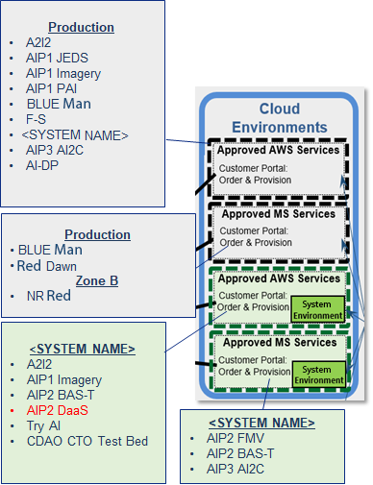
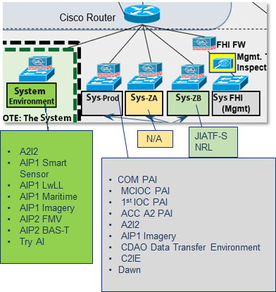
Mission Partners in SYSTEM NAME As of Date
On Premises
Cloud
EXAMPLES
EXAMPLE of a cloud-based system authorization boundary
Notes:
Reference Only…replace Mission Partners
In this case, this program shows a second chart to outline the workloads within the system.
Note that this is a second authorization boundary chart, in more detail.
It’s the Operational view of how the capability is being used, the 18 different workloads inside the capability.
The various cloud zones of the capability (e.g. prod, ZA, ZB, etc.). This gives the AO and team an understanding of the “how” the capability being authorized is being used.

Slide 13
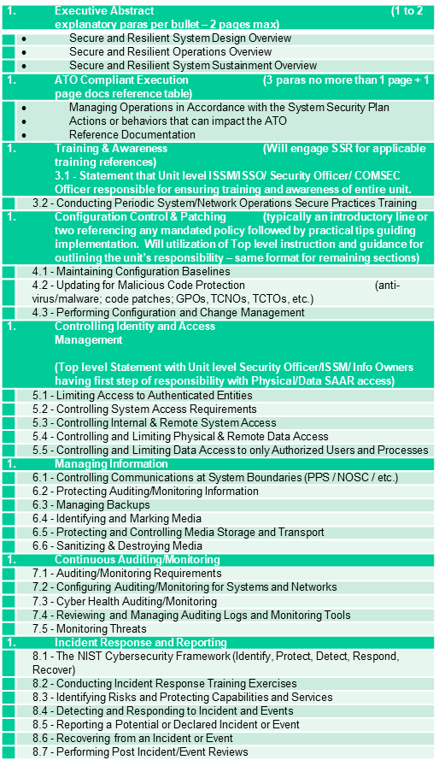
Cyber Tech Order and Continuous Monitoring
Provide the status and location of the items listed in the table to the right.
Cyber Tech Order:
Communicate the “How” to maintain systems for Secure Resiliency.
Provide clear operating instructions for users and maintainers.
Educate, enable, and execute.
Continuous Monitoring:
Recognize that change is constant.
New vulnerabilities and threats appear every day.
Technology changes.
Mitigation effectiveness degrades over time.
Outline ALL cyber related process for the system/capability.
These represent the set of instructions/process that are used to sustain the system authorization, to have the CONMON and insight into the system risk posture.
Notes:
Reference Only…replace architecture
The authorization boundary diagram must specifically identify what is included in the boundary. The AO risk acceptance determination will be strictly based on threat/vulnerability pairs identified within the specific boundary.

Slide 14
CDAO ORTB (1/2) (Organizational Risk Tolerance Baseline)
1. Account Management (Aligns to ORTB: AC-2) Monitor and Enforce user and group account creation/deletion 2. Administrative Privileged Accounts (Aligns to ORTB: AC-6) Privileged user/service accounts are only authorized to perform security relevant functions. Review and approve annually. 3. Audit Review, Analysis, and Reporting (Aligns to ORTB: AU-6) Review and analyze Information System (IS) audit logs for indications of inappropriate or unusual activity and reports findings to designated personnel IAW IRP 4. Boundary Protection (Aligns to ORTB: SC-7) Monitors and controls communications at the external boundary of the system and at key internal boundaries within the system 5. Continuous Monitoring (Aligns to ORTB: CA-7) System level monitoring metrics, including control monitoring frequencies, are defined by the organization and approved by the AO 6. Data Integrity (Aligns to ORTB: SI-7) Employ automated tools to report system (hw/sw/fw) and information (data) integrity violations. Ensure automatic integrity validation of all electronically transmitted software and data 7. External Connections (Aligns to ORTB: CA-3) Agreement/authorization used to approve external connections and manage the exchange of information should be defined (ATC, ISA, CSA, ICD, etc.) and reviewed annually 8. External Media (Aligns to ORTB: AC-4, MP-7) If authorized, place configuration control process on all external media including auditing. Institute external media whitelisting. Implement processes to monitor logs and audit usages. 9. Information Flow Enforcement (Aligns to ORTB: AC-4) The information system enforces approved connections for controlling the flow of information within the system and between interconnected systems | 10. Least Privilege (Aligns to ORTB: AC-6) Reviews, at least annually, the privileges assigned to privileged user accounts including Designated Transfer Agent and Trusted Cloud Credential Manager roles 11. Operational Change Mgmt (Aligns to ORTB: CM-8, CM-8(3), SI-7) Automated mechanisms shall be used to detect the presence of unauthorized hardware/software/firmware within the system. One or more of the following action shall be taken upon discovery of unauthorized components: disable network access by unauthorized components; isolate unauthorized components; notify designated personnel identified in IRP 12. Proposed Equipment (Aligns to ORTB: SA-22 – applies to C.I.A. impact High on non-SAP systems, CM-3) Lock down all mission support systems and migrate off unsupported operating systems. Review support agreements (hw/sw/fw) annually 13. Protection of Information at Rest (Aligns to ORTB: SC-28, SC-28(1)) Encryption is implemented to complement protection of information at rest, using approved cryptographic methods for data encryption 14. Secure Baseline Configuration (Aligns to ORTB: CM-2, CM-6) This Information System's secure configuration includes DoD Security Technical Implementation Guides or industry best practices and verified conformance prior to introduction into production or operational environments 15. Security Categorization (Aligns to ORTB: RA-2) Enforce proper security categorization and review annually 16. Separation of Duties (Aligns to ORTB: AC-5) Separates defined duties of individuals and documents separation of duties of individuals 17. Vulnerability / Anti-Virus Scanning (Aligns to ORTB: RA-5) Conduct routine anti-virus scans on traditional IT systems and hosted applications. Institute continuous monitoring protection on all IT systems to include maintenance and testing support systems
*Red font indicates specific JSIG, Non-Tailorable controls
Foundational ORTB

Slide 15
CDAO ORTB – AI View (2/2) (Organizational Risk Tolerance Baseline)
Cyber risks for AI are not new. AI risks are inherently covered by the CDAO ORTB. Each of the AI-Specific Views below tie back to multiple ORTB risks numbers noted on slide 1 of 2.
AI Foundation (Aligns to CDAO ORTB: 4/5/6/13/17) Encrypt any stored AI-related data and models Regularly patch AI components (hardware and software) on known vulnerabilities and update threat definitions Account for vetting of AI supply chain Data Integrity (Aligns to CDAO ORTB: 4/6/9/11/17) Depict provenance and lineage of datasets used for training models Implement mechanisms that ensures the integrity and authenticity of ingested data against adversarial attacks. Ensure privacy of personal data, anonymizing information where necessary Establish data retention and disposal mechanisms Model Management (Aligns to CDAO ORTB: 3/4/11/17) Depict architecture, justification, and rationale for the selection of a specific model Establish regular evaluation and validation procedures of training models Ensure rollback mechanism for models, configurations, and training data | Operational Resilience (Aligns to CDAO ORTB: 3/5/14/17) Regularly employ red teaming testing methodologies and maintain logs of outcomes Continuously monitor system performance metrics against predefined benchmarks or thresholds for validation User Interaction (Aligns to CDAO ORTB: 1/2/10/16) Incorporate mechanisms for users or other stakeholders to provide feedback on model output Implement oversight on user interactions, including data input, queries, and code base changes Responsible Accountability (Aligns to CDAO ORTB: NEW) Implement tools and/or methodologies that can elucidate model decisions Implement DoD Responsable AI (RAI) Principles
*Green font indicates Linkage back to CDAO ORTB
Foundational ORTB

Slide 16
Risk Assessment Model
Describe your overall “Threat” Environment:
<List “Known” Threats, Weaknesses, and Vulnerabilities>
<List “Unknown” Threats, Weaknesses, and Vulnerabilities>
<Describe adversary – created vulnerabilities>
Describe your environment in which risk-based determinations are made.
How do you assess risk within the context of your organization?
How is your organization responding to risk once that risk is determined?
How is your organization monitoring risk over time?
See notes below for further guidance.
Notes:
Refer to NIST SP 800-30 DoD Risk Assessment Guide Task 2.3.1
Risk models define the risk factors to be assessed and the relationships among those factors. Risk factors are characteristics used in risk models as inputs to determining levels of risk in risk assessments. Risk factors are also used extensively in risk communications to highlight what strongly affects the levels of risk in particular situations, circumstances, or contexts. Typical risk factors include threat, vulnerability, impact, likelihood, and predisposing condition. Risk factors can be decomposed into more detailed characteristics (e.g., threats decomposed into threat sources and threat events).
1. The purpose of the risk framing component is to produce a risk management strategy that addresses how your organization intends to assess risk, respond to risk, and monitor risk—making explicit and transparent the risk perceptions that your organizations routinely uses in making both investment and operational decisions. The risk management strategy establishes a foundation for managing risk and delineates the boundaries for risk-based decisions within organizations.
2. The purpose of the risk assessment component is to identify: (i) threats to organizations (i.e., operations, assets, or individuals) or threats directed through organizations against other organizations or the Nation; (ii) vulnerabilities internal and external to organizations; (iii) the harm (i.e., adverse impact) that may occur given the potential for threats exploiting vulnerabilities; and (iv) the likelihood that harm will occur. The result is a determination of risk (i.e., typically a function of the degree of harm and likelihood of harm occurring).
3. The purpose of your organizations risk response component is to provide a consistent, organization-wide response to risk in accordance with the organizational risk frame by: (i) developing alternative courses of action for responding to risk; (ii) evaluating the alternative courses of action; (iii) determining appropriate courses of action consistent with organizational risk tolerance; and (iv) implementing risk responses based on selected courses of action.
4. The purpose of your risk monitoring component is to: (i) determine the ongoing effectiveness of risk responses (consistent with the organizational risk frame); (ii) identify risk-impacting changes to organizational information systems and the environments in which the systems operate; and (iii) verify that planned risk responses are implemented and information security requirements derived from and traceable to organizational missions/business functions, federal legislation, directives, regulations, policies, standards, and guidelines are satisfied.

Slide 17
Assessment Approach
Assessment Details: <Provide details of verification testing performed; who, what, when, where i.e., virtual or onsite>.
Organization conducting verification testing.
Day/Month/Year.
Test Plan/Location <Include Test Plan with brief>.
Risk: <Describe risk approach>.
The risk approach should be supported by a series of security standards, best practices and guidelines necessary for managing information security risk.
Analysis: <Insert analysis approach>.
Analysis approaches differ with respect to the orientation or starting point of the risk assessment, level of detail in the assessment, and how risks due to similar threat scenarios are treated. An analysis approach can be: (i) threat-oriented; (ii) asset/impact-oriented; or (iii) vulnerability-oriented.
Notes:
Defer to NIST SP 800-30 Rev1; NIST SP 800-53 Rev4; NIST SP 800-39; CNSSI 4009-2015
First and Foremost… THINK OUTSIDE THE BOX! Don’t rely on a checklist approach when conducting your analysis and assessments.
Leveraging the tools and resources available to you via RMF will ensure that you are mitigating the necessary risks from a DoD standard, but you MUST always look at each assessment individually and ensure that it is properly tailored to meet the amount of security that makes the most strategic and mission sense moving forward.
How
Analysis approaches differ with respect to the orientation or starting point of the risk assessment, level of detail in the assessment, and how risks due to similar threat scenarios are treated. An analysis approach can be: (i) threat-oriented; (ii) asset/impact-oriented; or (iii) vulnerability-oriented.
Why
A threat-oriented approach starts with the identification of threat sources and threat events and focuses on the development of threat scenarios; vulnerabilities are identified in the context of threats, and for adversarial threats, impacts are identified based on adversary intent.
An asset/impact-oriented approach starts with the identification of impacts or consequences of concern and critical assets, possibly using the results of a mission or business impact analyses and identifying threat events that could lead to and/or threat sources that could seek those impacts or consequences.
A vulnerability-oriented approach starts with a set of predisposing conditions or exploitable weaknesses/deficiencies in organizational information systems or the environments in which the systems operate and identifies threat events that could exercise those vulnerabilities together with possible consequences of vulnerabilities being exercised. Each analysis approach takes into consideration the same risk factors, and thus entails the same set of risk assessment activities, albeit in different order.
Differences in the starting point of the risk assessment can potentially bias the results, causing some risks not to be identified. Therefore, identification of risks from a second orientation (e.g., complementing a threat-oriented analysis approach with an asset/impact-oriented analysis approach) can improve the rigor and effectiveness of the analysis.
CRA Recommendation
Based on the Body of Evidence provided, the CRA must be able to summarize risk assessment results, in a form that enables decision makers to quickly understand the overall risk, while considering the number of threat events for different combinations of likelihood and impact, the relative proportion of threat events at different risk levels.

Slide 18
Assessment Approach (Cont.)
Assumptions/Constraints: <Identify assumptions or constraints during risk assessment>.
As part of the risk management process, your organization must make explicit the specific assumptions, constraints, risk tolerance, and priorities/trade-offs used within your organization to make investment and operational determinations.
CRA Confidence Level: <Identify based on evidence from Body of Evidence (BOE) and/or site visit>.
Low: incomplete/inaccurate BOE; System unavailable during site visit.
Moderate: Unable to visit site to conclude that security is implemented as documented. Relied on provided evidence.
High: Project Management Office (PMO) provided Pre-Risk Assessment Evidence; Onsite or Virtual validation successful.
Notes:
Defer to NIST SP 800-30 Rev1; NIST SP 800-53 Rev4; NIST SP 800-39; CNSSI 4009-2015
First and Foremost… THINK OUTSIDE THE BOX! Don’t rely on a checklist approach when conducting your analysis and assessments.
Leveraging the tools and resources available to you via RMF will ensure that you are mitigating the necessary risks from a DoD standard, but you MUST always look at each assessment individually and ensure that it is properly tailored to meet the amount of security that makes the most strategic and mission sense moving forward.
How
Analysis approaches differ with respect to the orientation or starting point of the risk assessment, level of detail in the assessment, and how risks due to similar threat scenarios are treated. An analysis approach can be: (i) threat-oriented; (ii) asset/impact-oriented; or (iii) vulnerability-oriented.
Why
A threat-oriented approach starts with the identification of threat sources and threat events and focuses on the development of threat scenarios; vulnerabilities are identified in the context of threats, and for adversarial threats, impacts are identified based on adversary intent.
An asset/impact-oriented approach starts with the identification of impacts or consequences of concern and critical assets, possibly using the results of a mission or business impact analyses and identifying threat events that could lead to and/or threat sources that could seek those impacts or consequences.
A vulnerability-oriented approach starts with a set of predisposing conditions or exploitable weaknesses/deficiencies in organizational information systems or the environments in which the systems operate and identifies threat events that could exercise those vulnerabilities together with possible consequences of vulnerabilities being exercised. Each analysis approach takes into consideration the same risk factors, and thus entails the same set of risk assessment activities, albeit in different order.
Differences in the starting point of the risk assessment can potentially bias the results, causing some risks not to be identified. Therefore, identification of risks from a second orientation (e.g., complementing a threat-oriented analysis approach with an asset/impact-oriented analysis approach) can improve the rigor and effectiveness of the analysis.
CRA Recommendation
Based on the Body of Evidence provided, the CRA must be able to summarize risk assessment results, in a form that enables decision makers to quickly understand the overall risk, while considering the number of threat events for different combinations of likelihood and impact, the relative proportion of threat events at different risk levels.

Slide 19
Cyber Test Schedule
System Name | Testing Entity | SYSTEM NAME Environment | Status | Start Date | End Data
Identify all cyber related testing that provides insight in the risk posture
Notes:
NOTE: Larger than just pen test view. More overall testing view.

Slide 20
PenTest Schedule
<Provide stakeholder agreed upon Testing Schedule in support of this specific effort.>
Pen Test Playbook (Vendor Dependent).
<Insert Schedule>
<If testing has been completed, provide results via appropriate channels.>
System Name | Environment | Status | Start Date | End Date
Persistent Pen Testing is key to having continuous CONMON
Notes:
This chart and the next chart will show what pen tests or other tests are planned and when. There is a holistic site picture.
Could also be augmented by a traditional schedule view
Provide stakeholder agreed upon Testing Schedule in support of this specific effort
If testing has been completed, provide results via appropriate channels.>
Please see NIST SP 800-115, Technical Guide to Information Security Testing and Assessment
A penetration test, aka known as a “Pen test” or “Ethical Hacking”, is an authorized simulated cyberattack on an Information System, performed to evaluate the security state of the system.
Pen testing is an augmentation to the overall risk assessment and continuous monitoring. Not stand-alone or separate but augmented.
Coordinate and schedule with your contracted Pen testing team to ensure that you are getting your Information System Pen testing accomplished and the findings of the Pen test are published to the organization that are submitted up as part of the Authorizing Officials required Body of Evidence.
Penetration testing usually relies on performing both network port/service identification and vulnerability scanning to identify hosts and services that may be targets for future penetration. Also, multiple technical ways exist to meet an assessment requirement, such as determining whether patches have been applied properly.

Slide 21
Risk Scale Summary
R1 – Initial Risk Level
R1* – Residual Risk Level
LEVEL OF IMPACT
 | VERY LOW | LOW | MODERATE | HIGH | VERY HIGH
VERY HIGH | Very Low | Low | Moderate | High | Very High
HIGH | Very Low | Low | Moderate | High | Very High
MODERATE | Very Low | Low | Moderate | Moderate | High
LOW | Very Low | Low | Low | Low | Moderate
VERY LOW | Very Low | Very Low | Low | Low | Low
EXAMPLE
LIKELIHOOD
R2*
R2
R1
R3
R1*
R3*
Notes:
Reference Only, replace with your programs Risk Scale Summary diagram.
This table is from the DoD Risk Assessment Guide based on NIST SP 800-30, but reference NIST SP 800-39, Managing Information Security Risk to determine Level of Impact..
COMMUNICATE RISK ASSESSMENT RESULTS - TASK 3-1: Communicate risk assessment results to organizational decision makers to support risk responses.

Slide 22
Risk Analysis Report
Risk # R1 | Area of Concern (xxx) | Mechanisms (xxx) | Initial Risk Level (xxx)
Threat: <Describe the specific threat/threats that can potentially exploit this vulnerability.>
Vulnerability: <Describe the vulnerability.>
Likelihood: <What is the likelihood? Describe the likelihood of the vulnerability being exploited. Use means and opportunity.>
Impact: <What is the impact? Describe the impact of the vulnerability being exploited. Use criticality and impact.>
Mitigations In Place: <Describe the mitigations already in place.>
ADDITIONAL MEASURES APPLIED TO THE SYSTEM
Countermeasures Added: <Describe additional mitigations to lower the likelihood or impact of this vulnerability being exploited.>
Residual Risk: <If mitigations in place and or added countermeasures lowered the likelihood or impact, then the residual risk level could be lowered.> |  |  | Residual Risk (xxx)
Additional Countermeasures Suggested: <What further actions will be taken to reduce likelihood/impact in the future?>
Notes:
Reference Only, replace with your programs Risk Analysis Report.
Reference NIST SP 800-30 Rev1
The process of identifying, estimating, and prioritizing risks to organizational operations (including mission, functions, image, reputation), organizational assets, individuals, other organizations, and the Nation, resulting from the operation of an information system. Part of risk management, incorporates threat and vulnerability analyses, and considers mitigations provided by security risks planned or in place. Synonymous with risk analysis.

Slide 23
Mitigating Factors
Mitigating factors that reduce finding/risk:
<Describe operational, management, and technical findings.>
Standalone with limited access.
Armed guards providing 24x7 physical protection.
CD/DVD media is scanned and approved by IAO prior to being introduced to system.
Users are trained regularly and are aware of impact if unauthorized media is introduced to system – only IAO is allowed to introduce media.
Notes:
You’ve identified the risks, please explain how to mitigate each of the findings.
Refer to NIST SP 800-39, Managing Information Security Risk
(i.e. Scan Results, Penetration Test Findings, PPSM)

Slide 24
Summary
<The CRA provides this summary to the AO for validation of risk recommendation.>
Notes:
This is the summary template chart.
The intent is a program would add its own summary here.
NOTE: this is not the AO summary – The CRA to add their own summary.

Slide 25
Back-Up Slides
Notes:
Provide any additional information in the backup slides as needed.

Slide 26
Cloud Slides
Notes:
Remove this section if it does not apply

Slide 27
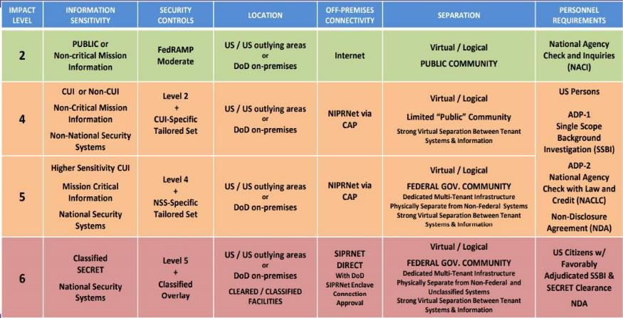
Impact Level Comparison
<Note: Remove this slide prior to presenting brief.>
Notes:
Reference only, remove slide before submission.
See “DoD Cloud Computing SRG v1 Rev 3, Section 3.2 Information Impact Levels” for further guidance.

Slide 28
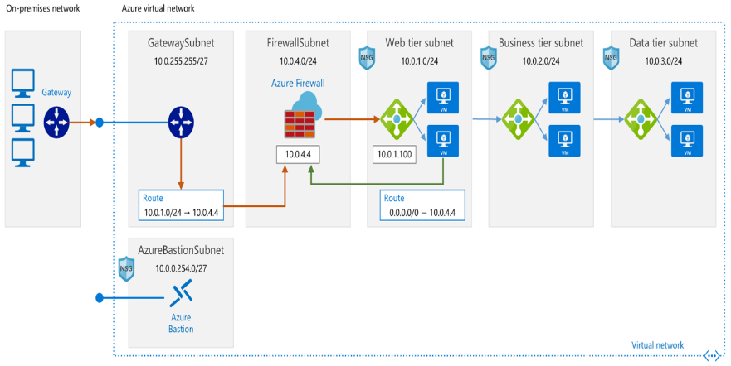
Cloud System Architecture
<Insert diagram or describe system architecture if necessary.>
Notes:
Reference Only…replace architecture
Defer to DoD Secure Cloud Computing Architecture Functional Requirements (SCCA)
https://dl.dod.cyber.mil/wp-content/uploads/cloud/pdf/SCCA_FRD_v2-9.pdf
The system architecture should show the AO what the architecture is, physical location, encryption, interfaces and protocols, physical and technical protection mechanisms, vendor access, etc.
Ensure you are showing your supporting infrastructure service(s) (IaaS, SaaS, PaaS) and show your Development Security Operations Platform (DSOP).
A system Architecture is the conceptual model that defines the structure, behavior, and more views of a system. An architecture description is a formal description and representation of a system, organized in a way that supports reasoning about the structures and behaviors of the system. Identify the architecture, locations, encryption, interfaces, protocols, physical and technical protection measures, vendor access, etc.

Slide 29
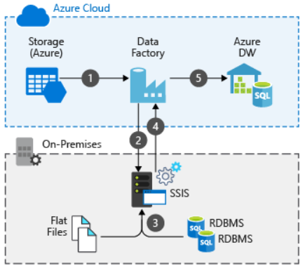
Cloud Data Flow Diagram
<Insert diagram or describe internal and external information flow, if necessary.>
Notes:
Replace with your program's information systems data flow diagram.
Defer to NISTIR 8179 Criticality Analysis Process Model
https://csrc.nist.gov/CSRC/media/Publications/nistir/8179/draft/documents/nistir-8179-draft.pdf
The Data Flow diagram must specifically identify what the data flow connections look like within and leaving the defined boundaries. The AO risk acceptance decision will be strictly based on threat/vulnerability pairs identified within the specific boundary.
In computing, the path of data from source document to data entry to processing to final reports. Data changes format and sequence (within a file) as it moves from program to program. A data-flow diagram is a way of representing a flow of data through a process or a system (usually an information system). The Data flow diagram also provides information about the outputs and inputs of each entity and the process itself. A data flow diagram has no risk flow, there are no decision rules and no loops. Data Flow Diagrams are used to graphically represent the flow of data in a business information system. Data flow diagrams describe the processes that are involved in a system to transfer data from the input to the file storage and reports generation. Data flow diagrams can be divided into logical and physical. A data flow diagram shows the way information flows through a process or system. It includes data inputs and outputs, data stores, and the various subprocesses the data moves through. Data flow diagrams are built using standardized symbols and notation to describe various entities and their relationships.

Slide 30
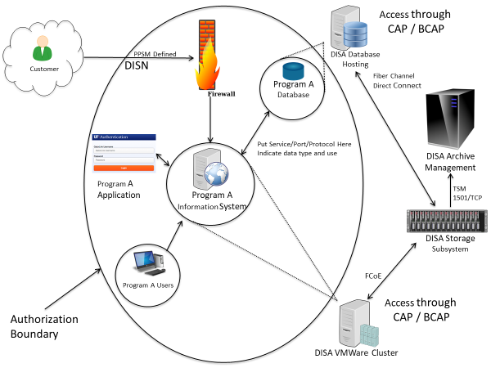
Cloud Authorization Boundary
<Insert diagram or describe authorization boundary, if necessary.>
Notes:
Replace with your programs information system boundary diagram.
Defer to NIST 800-37 Rev1 Guide for Applying the Risk Management Framework to Federal Information Systems, Security Lifecycle Approach
All components of an information system to be authorized for operation by an authorizing official and excludes separately authorized systems, to which the information system is connected.
Identify all areas that are to be included within the authorization determination. Any major component/device that is used within or by the system must be included in the boundary diagram, unless the component/device has its own authorization (proof required).
Interconnection(s)/Interface(s)
Defer to NIST SP 800-47 Security Guide for Interconnecting Information Technology Systems.
Include any/all Interconnection(s)/Interface(s) that would be leveraged – See below for further details.
The intent of the ISA is to document and formalize the interconnection arrangements between “Organization A” and “Organization B” and to specify any details that may be required to provide overall security safeguards for the systems being interconnected. ISAs are always negotiable.
General guidance regarding the contents of an ISA is provided below; however, an ISA may be tailored by mutual consent of the participating organizations.
A system that has an interconnection with another organization’s system, should meet the protection requirements equal to, or greater than, those implemented by the other organization’s system.

Slide 31
Cybersecurity Service Provider (CSSP) or Equivalent Services
<Identify your organization’s Certified CSSP or how you are addressing your CSSP equivalent services.>
What is your program on contract for with the certified CSSP?
What are the details of the SLA?
If no Certified CSSP provider:
Do you plan to obtain a CSSP provider?
How is your program planning to meet/execute these services?
Do you need assistance with obtaining a CSSP?
How are you meeting the Mission Owner CSSP responsibilities (this is independent of the Certified CSSP responsibilities)?
Notes:
If you are providing your own services, please explain what services are being conducted and please include what DoD support has been approved or needed.
Per DoD Mandate 17-0019, DoDI 8530.01 you need a Cybersecurity Service Provider (CSSP), or your organization needs to be able to support similar services that meet the DoD requirements. CSSP are required for both on premises and cloud Information Systems. Establish Cyber Defense (CD) services through one of the 23 DoD certified Cyber Security Service Providers (CSSP) for Mission Cyber Defense (MCD)

Slide 32
Equivalent CSSP Services
CSSP services include but are not limited to:
External Vulnerability Scans (EVS)
Web Vulnerability Scanning (WVS)
Malware Notification Protection (MNP)
Support and Training (S&T)
Network Security Monitoring (NSM)
Attack Sensing & Warning (ASW)
Warning Intelligence (WI)
Incident Reporting (IR)
Incident response Support (IRS)
Volatile Data Analysis (VDA)
Forensic Media Analysis (FMA)
Reverse Engineering and Malware Analysis (RE/MA)
Cyber Hunt/Intrusion Assessment (IA)
Incident Response (IR)
Sustainment & Configuration Management (SCM)
HBSS or DoD approved equivalent Anti-Virus
Port Whitelisting through DISA
<Note: Remove this slide prior to presenting brief.>

Slide 33
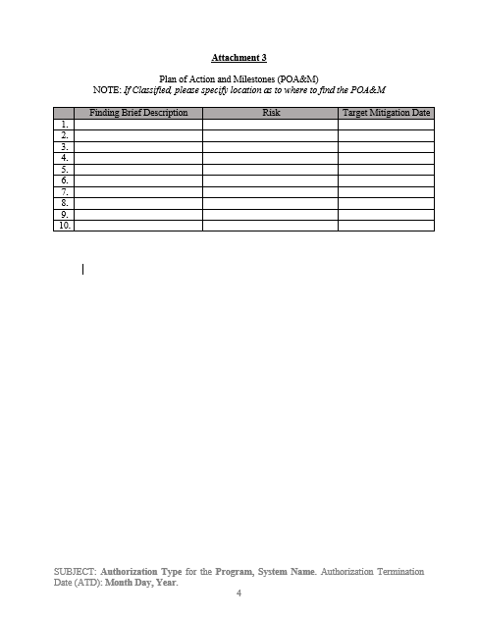
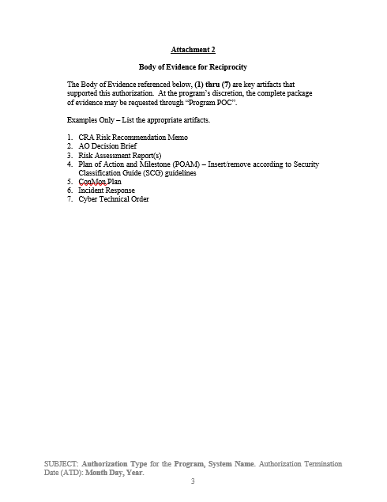
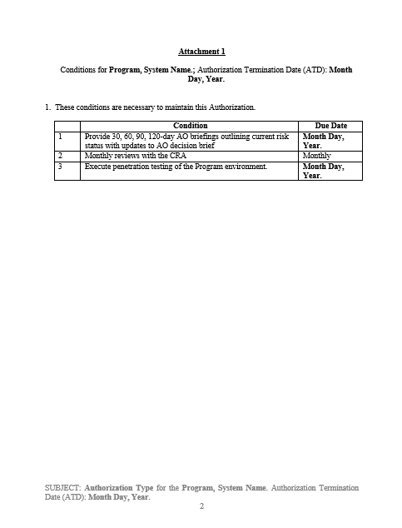
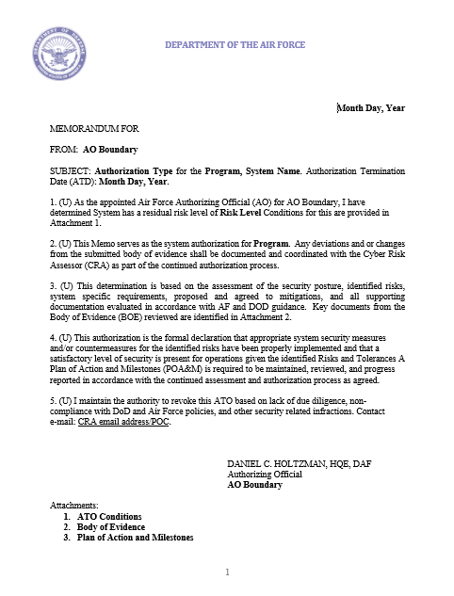
Authorization Package
The authorization package artifacts maintained in an RMF Inventory Tool system of record (e.g., eMASS, Xacta, etc..)
Authorization Package (AO Responsibility)
AO Determination Brief.
Authorization Memo:
Attachment 1 – Conditions.
Attachment 2 – BOE.
Attachment 3 – ITCSC.
Body of Evidence (PM Responsibility)
​(Example listing, but not limited to):
SSP​​
CONOPs​​
SCTM​​
STIG’s​​
ACAS Scans​​
ConMon Plan​​
Incident Response Plan​​
Contingency Plan​​
POA&M​​
Cybersecurity Strategy​
Other evidence as required.
Authorization Package
Body of Evidence

Slide 34
Authorization Determination Table
Authorization Type | Authorization Details | Documentation
ATO | The risk to organizational operations, organizational assets, individuals, other organizations, and the Nation is acceptable. | AO Determination Brief. AO Authorization Memo. CRA Risk Recommendation. Plan of Action and Milestones. IT Categorization and Selection Checklist. Reference: Supporting Evidence.
ATO With Conditions (ATO-C) | The risk to organizational operations, organizational assets, individuals, other organizations, and the Nation is acceptable, but conditions exist. | AO Determination Brief. AO Authorization Memo. CRA Risk Recommendation. Plan of Action and Milestones. IT Categorization and Selection Checklist. Reference: Supporting Evidence.
Continuous ATO (c-ATO) (Applied to DevSecOps ONLY) | Accredits the platform and process and certifies team that produces a product under a continuous monitoring process that maintains the residual risk within the risk tolerance of the Authorizing Official (AO). | AO Determination Brief. CRA Risk Recommendation. CONOPs: platform, process, and teams. IT Categorization and Selection Checklist. Reference: Supporting Evidence.
IATT | Operational environment or live data is required to complete specific test objectives. | AO Determination Brief. CRA Risk Recommendation. IT Categorization and Selection Checklist. Certification Test Plan. Reference: Supporting Evidence.

Slide 35
Authorization Determination Table (Cont.)
Authorization Type | Authorization Details | Documentation
Authorization to Use (ATU) | AO acceptance of risk in using cloud or shared services (system, service, or application) chooses to accept the system, service, or application in an existing authorization package produced by another organization. Authorization to use is a mechanism to promote reciprocity for systems under the purview of different AOs, based on a need to use shared systems, services, or applications. | AO Determination Brief. CRA Risk Recommendation. Plan of Action and Milestones. IT Categorization and Selection Checklist. Reference: Supporting Evidence.
Certificate to Field (CtF) | Trustworthiness ensures no risks exist, either of malicious or unintentional origin. Predictable execution ensures there is a justifiable confidence that software, when executed, functions as intended. | AO Determination Brief. CRA Risk Recommendation. Plan of Action and Milestones. IT Categorization and Selection Checklist. Reference: Supporting Evidence.
DATO | The information system is not authorized to operate. | DATO Memo.

Slide 36
SAP Protection Levels
<Note: If not Special Access Program, remove slide prior to presenting brief.>
<Note: Define the Protection Level to set the Risk Assessment Tolerance.>
Lowest Clearance | Formal Access Approval | Need-to-Know | Protection Level
At Least Equal to Highest Data | All Users Have ALL | All Users Have ALL | 1
At Least Equal to Highest Data | All Users Have ALL | NOT ALL Users Have ALL | 2
At Least Equal to Highest Data | NOT ALL users have ALL | Not Contributing to Determination | 3
Secret | Not Contributing to Determination | Not Contributing to Determination | 4
Notes:
The concept of Protection Levels applies only to confidentiality. Having verified that an IS will maintain, process, or transmit intelligence information and therefore that its Level of
Concern for confidentiality must be High, the AO will ascertain the appropriate Protection Level for the IS based on the required clearance(s), formal access approval(s), and
need-to-know of all direct and indirect users who receive information from the IS without manual intervention and reliable human review. It indicates an implicit level of trust that is
placed in the system’s technical capabilities.
Determining Protection Levels
An IS operates at Protection Level 1 when all users have all required approvals for access to all information on the IS. This means that all users have all required clearances, formal access approvals,
and the need to know for all information on the IS.
An IS operates at Protection Level 2 when all users have all required formal approvals for access to all information on the IS, but at least one user lacks administrative approval for some of the
information on the IS. This means that all users have all required clearances, and all required formal access approvals, but at least one user lacks the need to know for some of the information on the
IS.
An IS operates at Protection Level 3 when at least one user lacks at least one required formal approval for access to all information on the IS. This means that all users have all required clearances,
but at least one user lacks formal access approval for some of the information on the IS.
An IS operates at Protection Level 4 when at least one user lacks sufficient clearance for access to some of the information on the IS, but all users have at least a Secret clearance.
An IS operates at Protection Level 5 when at least one user lacks any clearance for access to some of the information on the IS.

Slide 37
SAP Body of Evidence
<Note: If not Special Access Program, remove slide prior to presenting brief.>
Authorization Package (AO Responsibility)
AO Determination Brief.
Authorization Memo:
Attachment 1 – Conditions.
Attachment 2 – BOE.
Attachment 3 – Signed ITCSC.
* Items Marked can be included as part of the
System Security Plan Or can be referenced
in the AO Determination Briefing
Body of Evidence (PM Responsibility)
​(Example listing, but not limited to):
POA&M​.
CONOPs​.
Cybersecurity Strategy.
ConMon Plan.
Incident Response Plan.
Contingency Plan​.
SSP​.
SCTM​.
STIGs.
ACAS Scans​.
Topology*.
Hardware List*.
Software List*.
Security Technical Implementation Guide (STIG) applicability list.
Ports, Protocols, and Service Matrix and registration number.
Vulnerability scans (if applicable, analyzed and sated within 60 days of submission).
STIG Compliance scans (if applicable, analyzed and dated within 60 days of submission).
Note: BOE Items Required to be in CORE folder prior to Authorization approval.
Notes:
Signed Information Technology Security Categorization and Selection Checklist (ITSC).
System Security Plan.

Slide 38
SAP Connection Package Required Documentation
<Note: If not Special Access Program, remove slide prior to presenting brief.>
Interconnection Security Agreement (ISA) signed by AO.
Authorization to Operate - Signed by AO.
Existing ISAs/ATCs and ATOs for other external connections.
RAW Scan files (Nessus, XCCDF, etc.).
Evidence that all scans were credentialed.
Topology includes device function, OS, IP address, make/model.
POA&M must include all CAT I and Critical findings from scans on all devices.
Note: BOE Items Required to be in CORE folder prior to Authorization approval.

Slide 39
SAP ORTB
Account Management (AC-2): Monitor and Enforce user and group account creation/deletion. Administrative Privileged Accounts (AC-3): Privileged user/service accounts are only authorized to perform security-relevant functions. Review and approve annually. Audit Review, Analysis, and Reporting (AU-6): Review and analyze Information System (IS) audit logs for indications of inappropriate or unusual activity, and report findings to designated personnel IAW IRP. Boundary Protection (SC-7): Monitors and controls communications at the external boundary of the system and at key internal boundaries within the system. Continuous Monitoring (CA-7): System-level monitoring metrics, including control monitoring frequencies, are defined by the organization and approved by the AO. | Least Privilege ((AC-6) AC-6(1); DoD JSIG Non-Tailorable Control): Reviews, at least annually, the privileges assigned to privileged user accounts including Designated Transfer Agent and Trusted Cloud Credential Manager roles. Proposed Equipment ((SA-22) DoD JSIG Non-Tailorable Control): Lock down all mission support systems and migrate off unsupported operating systems. Review support agreements (hardware/software/firmware) annually. Protection of Information at Rest ((SC-28) DoD JSIG Non-Tailorable Control): Encryption is implemented to complement the protection of information at rest, using approved cryptographic methods for data encryption.
<Note: If not Special Access Program, remove slide prior to presenting brief.>
Notes:
Defer to Department of Defense (DoD) Joint Special Access Program (SAP) Implementation Guide (JSIG), 11 April 2016.
Cyber hygiene describes recommended mitigations for the small number of root causes responsible for many cybersecurity incidents. Implementing a few simple practices can address these common root causes.
The final determination of the appropriate set of risk areas supported by the risk mitigations is necessary to harden the IS and the environment in which those systems operate is a function of the assessment of risk and what is required to sufficiently mitigate the risks to the overall operations and assets, individuals, other organizations, and the Nation. In many cases, additional areas or enhancements will be required to address specific threats to and vulnerabilities in your organizations, mission/business processes, and/or information systems and to satisfy the requirements of applicable federal laws, Executive Orders, directives, policies, standards, or regulations. The risk assessment in the risk mitigation process provides essential information in determining the necessity and sufficiency of the risk areas and enhancements in the initial baselines.
1. AC-2; Account Management - Information System (IS) account types are defined by the organization and supporting mission and business functions are clearly defined.
2. AC-4; Information Flow Enforcement - The organization ensures that the information system enforces approved authorizations for controlling the flow of information within the system and between interconnected systems.
3. AC-5; Separation of Duties - Obtains and examines the documented duties to ensure the organization defines the duties of individuals that are to be separated.
4. AC-6; Least Privilege - The organization obtains and examines the documented processes to ensure that the organization implements the concept of least privilege, allowing only authorized accesses for users (and processes acting on behalf of users) which are necessary to accomplish assigned tasks in accordance with organizational missions and business functions.
LEAST PRIVILEGE | REVIEW OF USER PRIVILEGES The organization: (a) Reviews at least annually the privileges assigned to privileged user accounts including DTA role to validate the need for such privileges; and (b) Reassigns or removes privileges, if necessary, to correctly reflect organizational mission/business needs.
AC-6(1), Enhancement for Least Privilege needs to be addressed.
5. AU-6; Audit Review, Analysis, and Reporting - The organization defines the frequency for the review and analysis of information system audit records for organization-defined inappropriate or unusual activity.
6. SC-7; Boundary Protection - Obtains and examines network topology diagrams, architecture documentation, or any other documentation identifying component partitioning to ensure the organization implements subnetworks for publicly accessible system components that are physically and/or logically separated from internal organizational networks.
7. CM-6; Configuration Settings - Obtains and examines the documented process to ensure the organization monitors changes to the configuration settings in accordance with organizational policies and procedures.
8. RA-5; Vulnerability Scanning - Obtains and examines the contracts/agreements to ensure the organization requires that the developer provide administrator documentation for the information system, system component or information system service that describe secure configuration of the system, component, or service.
9. SA-22, Unsupported System Components - Replaces information system components when support for the components is no longer available from the developer, vendor, or manufacturer; and provides justification and documents approval for the continued use of unsupported system components required to satisfy mission and business needs.
10. SC-28, Protection of Information at Rest - Obtains and examines the documented information at rest to ensure the organization defines and documents the information at rest that is to be protected by the information system which must include, at a minimum, PII and classified information.

Slide 40
SAP ORTB (Cont.)
External Connections (CA-3): Agreement/authorization used to approve external connections and manage the exchange of information should be defined (ATC, ISA, CSA, ICD, etc.) and reviewed annually. External Media (AC-4, MP-7): If authorized, place configuration control process on all external media including auditing. Institute external media whitelisting. Implement processes to monitor logs and audit usage. Information Flow Enforcement (AC-4): The information system enforces approved connections for controlling the flow of information within the system and between interconnected systems. | Secure Baseline Configuration (CM-2, CM-6): This Information System's secure configuration includes DoD Security Technical Implementation Guides or industry best practices and verified conformance prior to introduction into production or operational environments. Security Categorization (RA-2): Enforce proper security categorization and review annually. Separation of Duties (AC-5): Separates defined duties of individuals and documents separation of duties of individuals. Vulnerability/Anti-Virus Scanning (RA-5): Conduct routine anti-virus scans on traditional IT systems and hosted applications.
<Note: If not Special Access Program, remove slide prior to presenting brief.>
Notes:
Defer to Department of Defense (DoD) Joint Special Access Program (SAP) Implementation Guide (JSIG), 11 April 2016.
Cyber hygiene describes recommended mitigations for the small number of root causes responsible for many cybersecurity incidents. Implementing a few simple practices can address these common root causes.
The final determination of the appropriate set of risk areas supported by the risk mitigations is necessary to harden the IS and the environment in which those systems operate is a function of the assessment of risk and what is required to sufficiently mitigate the risks to the overall operations and assets, individuals, other organizations, and the Nation. In many cases, additional areas or enhancements will be required to address specific threats to and vulnerabilities in your organizations, mission/business processes, and/or information systems and to satisfy the requirements of applicable federal laws, Executive Orders, directives, policies, standards, or regulations. The risk assessment in the risk mitigation process provides essential information in determining the necessity and sufficiency of the risk areas and enhancements in the initial baselines.
1. AC-2; Account Management - Information System (IS) account types are defined by the organization and supporting mission and business functions are clearly defined.
2. AC-4; Information Flow Enforcement - The organization ensures that the information system enforces approved authorizations for controlling the flow of information within the system and between interconnected systems.
3. AC-5; Separation of Duties - Obtains and examines the documented duties to ensure the organization defines the duties of individuals that are to be separated.
4. AC-6; Least Privilege - The organization obtains and examines the documented processes to ensure that the organization implements the concept of least privilege, allowing only authorized accesses for users (and processes acting on behalf of users) which are necessary to accomplish assigned tasks in accordance with organizational missions and business functions.
LEAST PRIVILEGE | REVIEW OF USER PRIVILEGES The organization: (a) Reviews at least annually the privileges assigned to privileged user accounts including DTA role to validate the need for such privileges; and (b) Reassigns or removes privileges, if necessary, to correctly reflect organizational mission/business needs.
AC-6(1), Enhancement for Least Privilege needs to be addressed.
5. AU-6; Audit Review, Analysis, and Reporting - The organization defines the frequency for the review and analysis of information system audit records for organization-defined inappropriate or unusual activity.
6. SC-7; Boundary Protection - Obtains and examines network topology diagrams, architecture documentation, or any other documentation identifying component partitioning to ensure the organization implements subnetworks for publicly accessible system components that are physically and/or logically separated from internal organizational networks.
7. CM-6; Configuration Settings - Obtains and examines the documented process to ensure the organization monitors changes to the configuration settings in accordance with organizational policies and procedures.
8. RA-5; Vulnerability Scanning - Obtains and examines the contracts/agreements to ensure the organization requires that the developer provide administrator documentation for the information system, system component or information system service that describe secure configuration of the system, component, or service.
9. SA-22, Unsupported System Components - Replaces information system components when support for the components is no longer available from the developer, vendor, or manufacturer; and provides justification and documents approval for the continued use of unsupported system components required to satisfy mission and business needs.
10. SC-28, Protection of Information at Rest - Obtains and examines the documented information at rest to ensure the organization defines and documents the information at rest that is to be protected by the information system which must include, at a minimum, PII and classified information.

